Slide 1
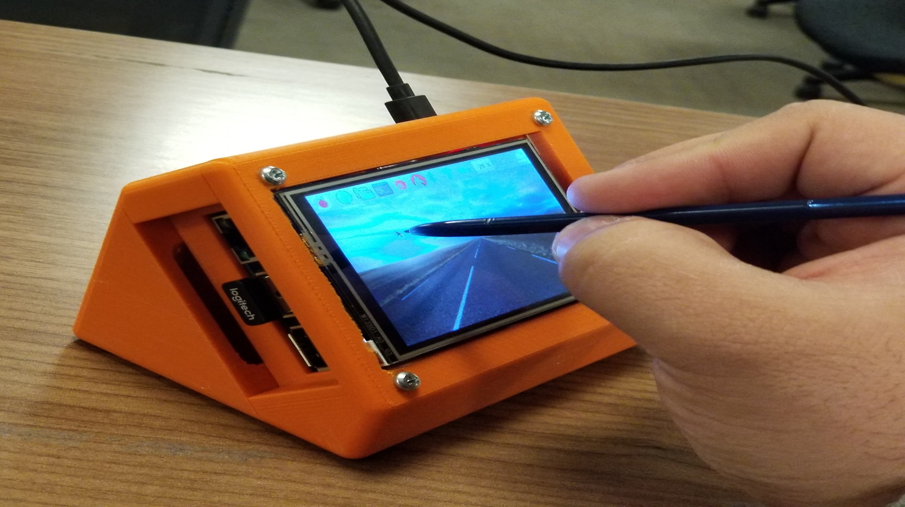
3.5`` Touchscreen
Made by: Saqib Jaweed Syed
N01152429

Slide 2
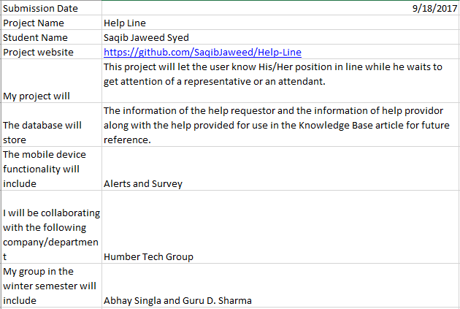
Introduction
Touch Screen for Raspberry Pi 3 Model B
Screen Size is 3.5`` made by Adafruit
Purpose is to display and take user’s input
Used Github to keep all project material together.
Acquired materials from Kijiji

Slide 3
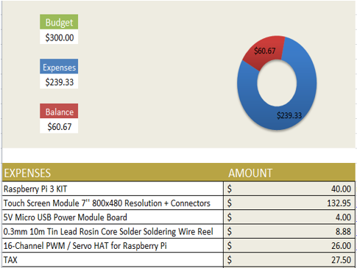
Budget
I ended up using only ¼ of my proposed budget.
Raspberry Pi 3 Module B Kit $30.00 3.5’’ Touch Screen Module for $20.00

Slide 4
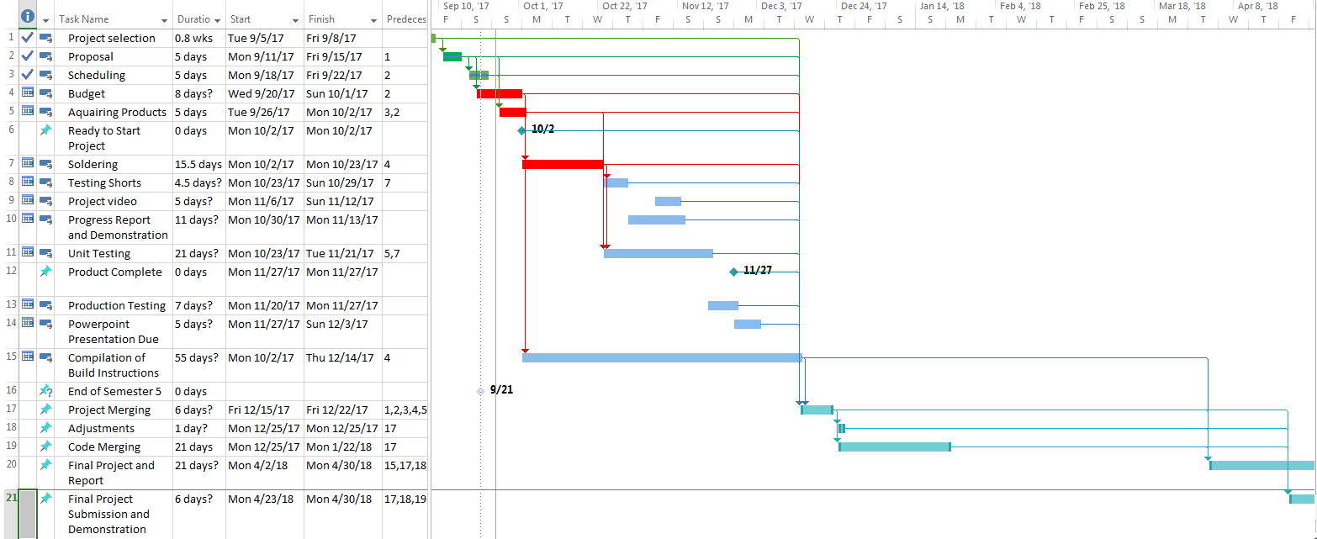
Schedule
Ahead of schedule due to strike
All testing complete
Build instructions also coming soon
Needs 2 hours to build with all instructions

Slide 5
Build Video
https://www.youtube.com/watch?v=JPZLsDThR3A&feature=youtu.be

Slide 6
Course Knowledge Utilized
Previous Courses:
Intro to Software Engineering:
Learned to create Gantt Charts for better scheduling and prioritizing tasks
Technical C:
We were taught how to get started with Raspberry Pi and how to use and configure GPIO pins.
This Course:
This was the only course which gave us an insight on how to play-around with Raspberry Pi and modify system settings to incorporate out sensors code into the Raspbian OS. Another very important skill we learned in this course was using Github effectively.

